Slide 1
Welcome to GFM’s online home.

Slide 2
First, explore “Our Ministries.”
Focused ministries are also available here.

Slide 3
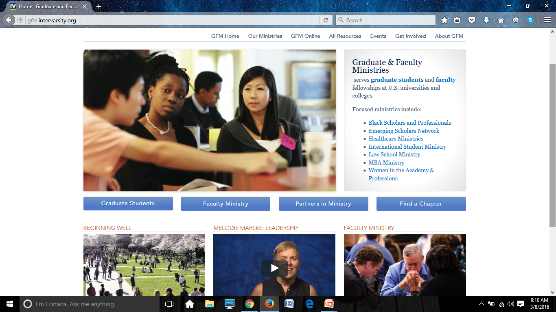
Where should my graduate students go?

Slide 4
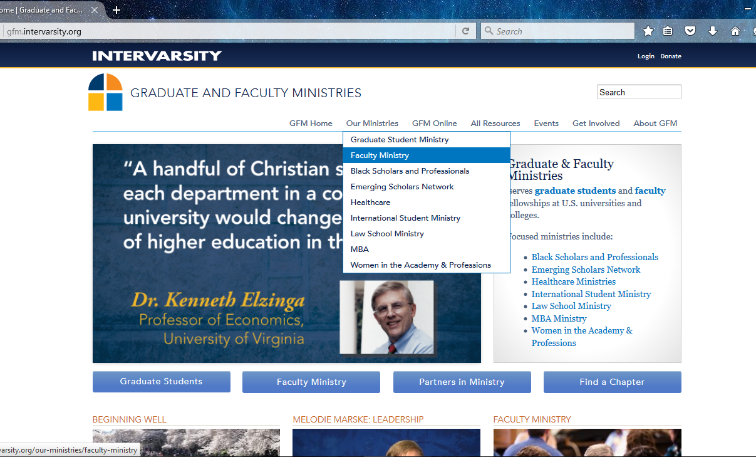
Where’s Faculty Ministry?

Slide 5
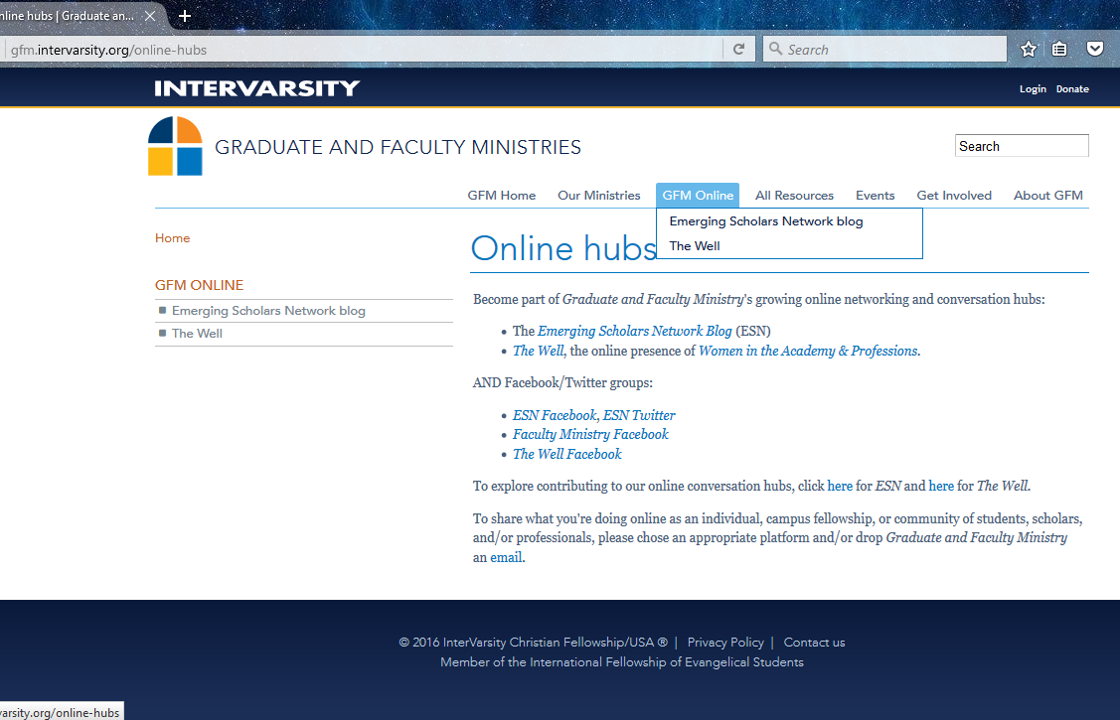
Links to Other GFM Sites

Slide 6
Where are the resources?
We added categories so you can sort by:
Four Commitments
Ministry
Staff Resources

Slide 7
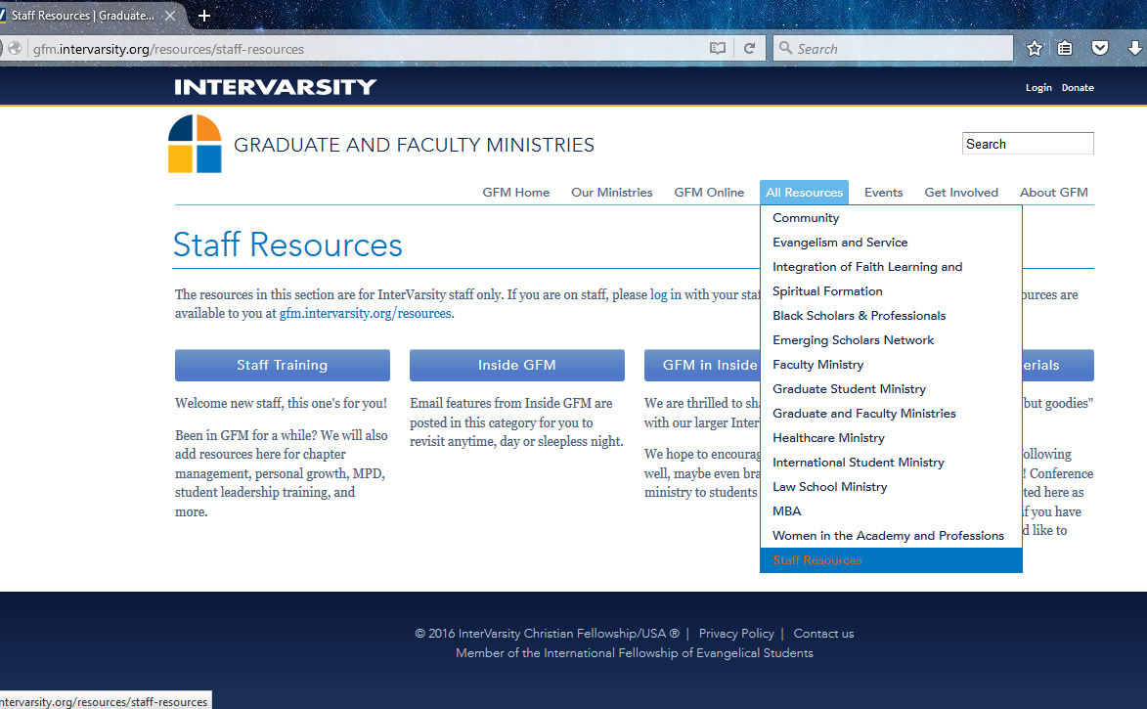
How about staff information?
Be sure to
LOG IN!
Here’s the link from the homepage.

Slide 8
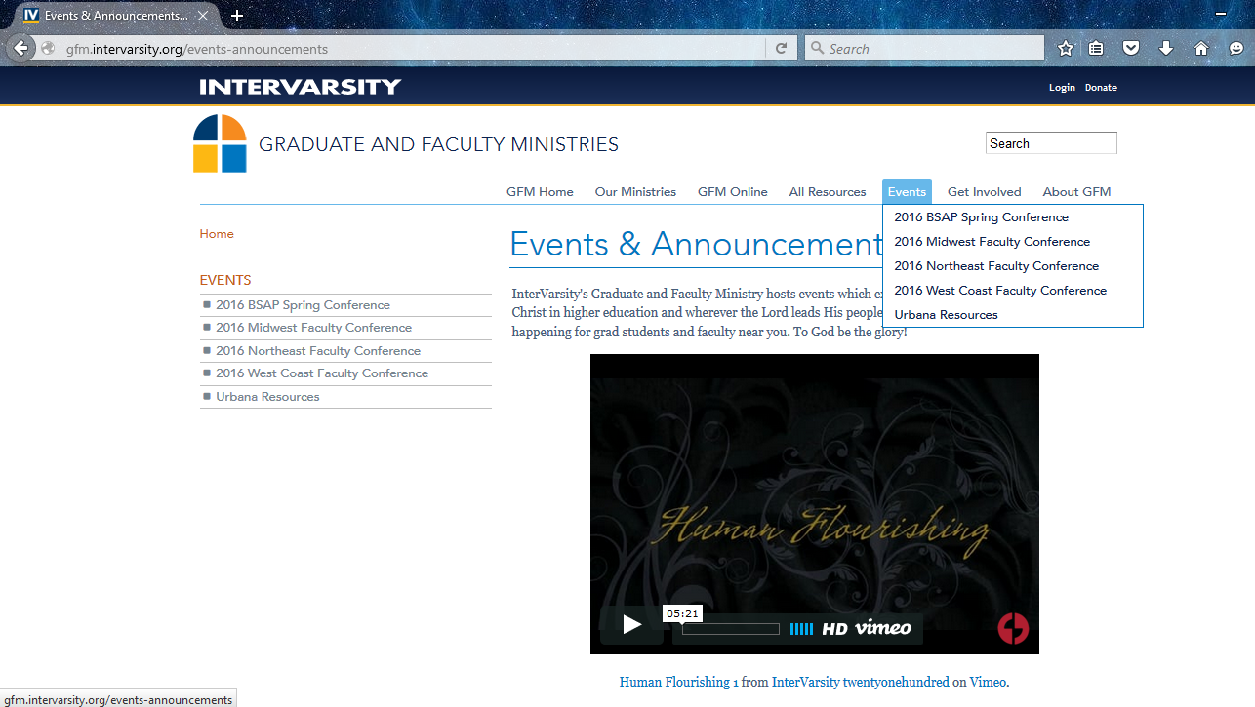
Check out upcoming events!

Slide 9
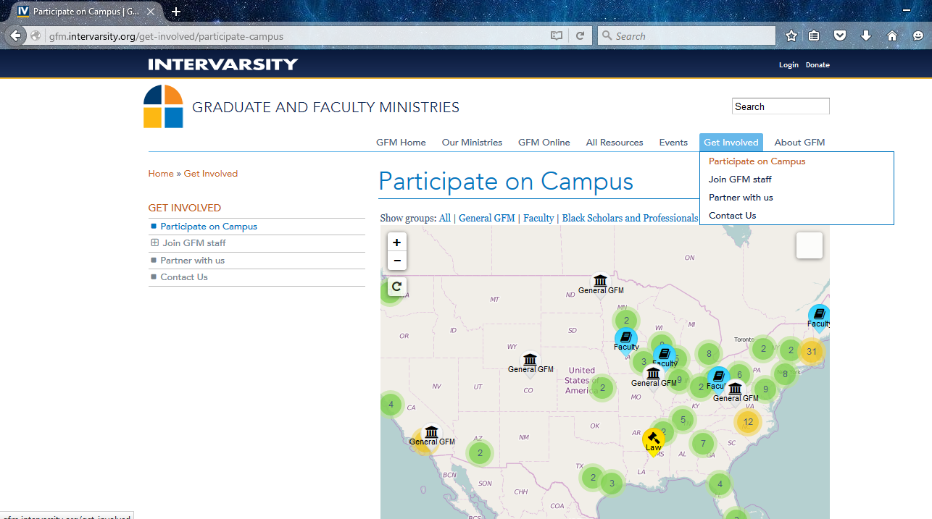
Share the Chapter Map
Here’s the link.

Slide 10
About GFM
A great place for new donors, students, faculty, pastors. Meet Graduate & Faculty Ministries.
Donor Information

Slide 11
Graduate Student Ministry Home
Menu
Feature Story

Slide 12
Faculty Ministry Home
Faculty Menu
Featured Resource, left
Campus Story, right

Slide 13
BSAP Ministry Home
Menu starts here.

Slide 14
Emerging Scholars Network Home
Rotating features
Testimonies
Menu

Slide 15
Healthcare Ministry Home
Highlights when you hover over with your mouse.

Slide 16
International Student Ministry Home

Slide 17
Law Student Ministry Home
Horizontal menu is still at the top, not shown.

Slide 18
MBA Ministry Home
Menu Links

Slide 19
Women in the Academy and Professions
This “home” on GFM is presently an “About Us” type page. Below is the homepage of The Well, the online ministry of WAP.
Feature story
Sign up to receive email updates!

Slide 20
est

