Slide 1
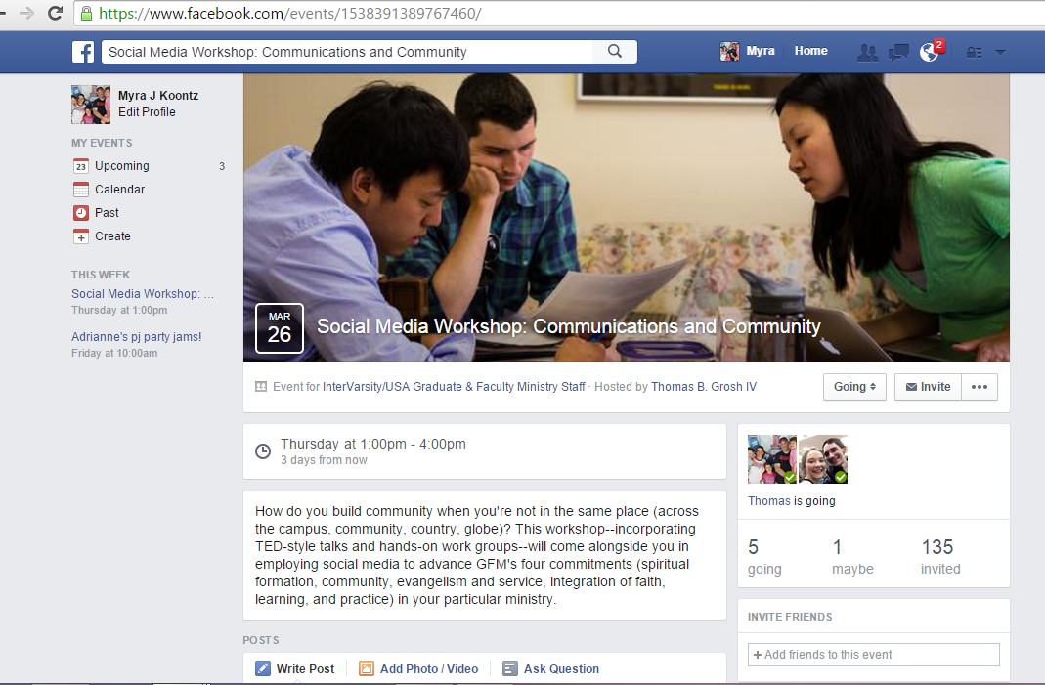
Social Media Workshop: Communications and Community

Slide 2
Email from The Well
Connect with contacts via email and link to your website, Facebook wall, Twitter feed, etc.

Slide 3
Law Ministry Email Newsletter
There are lots of email newsletter platforms.

Slide 4
Google+ Network
You may already receive email updates of what your “friends” post on Google+.

Slide 5
Sample Twitter Page
Click here to “follow” Hannah which means her posts will appear in your Twitter “feed.”

Slide 6
Simple First Step
#Urbana15
To group Tweets on a common thread, include a “hashtag” for users to copy when they post in Twitter.
To find a topic, use the Search bar or browse under #Discover.

Slide 7
Sample Twitter Page
Click here to change media type on Twitter.

Slide 8
Simple First Step
@esnivcf
is the Twitter “handle” for the Emerging Scholars Network.
Take care in choosing your screen name in Twitter. Your “followers” can include it in their Tweet or reTweet and it will appear in your “feed.”

Slide 9
IVCF National Facebook
This is a public Facebook page.

Slide 10
IVCF GFM Staff Facebook
A closed group on Facebook offers your donors, students, or faculty a private place to communicate.

Slide 11
Facebook Statistics
Facebook sends you emails with statistics on your site activity.

Slide 12
Faculty Ministry Facebook
Offer links to articles on related topics your community is currently considering.

Slide 13
Simple First Steps
Invite people at church, on campus, at conferences, etc. to “friend” you on Facebook so they can be a part of your community’s dialogue.
Networking starts in person, however, social networking online expands your community globally.

Slide 14
Instagram
Search on Instagram for your friends from other social networks and follow them to see what they are posting.
When you create an Instagram account you can choose to notify all of your friends on Facebook and they can follow you.

Slide 15
Simple First Steps
Host a best photo contest on Instagram and tell everyone in your network on every platform!
Any topic: good deeds, campus icons, best smile, whatever is current in your community.

Slide 16
Sample Website/Blog
You can share Bob’s resources with your network on Linked In.

Slide 17
Simple First Steps
To get your audience involved in your new platform, “share” it on whatever Social Media sites you already use AND in person!

